Slide 1
Employee Data Analysis using Excel
STUDENT NAME: R. LAVANYA
REGISTER NO: 122203888 (NM ID – 5C087CD76A6A0538CFE4D30546E64A21)
DEPARTMENT: III- BCOM (CORPORATE SECRETARYSHIP)
COLLEGE : SHRI SHANKARLAL SUNDARBAI SHASUN JAIN COLLEGE FOR WOMEN

Slide 2
PROJECT TITLE
Employee Performance Analysis using Excel

Slide 3


AGENDA
Problem Statement
Project Overview
End Users
Our Solution and Proposition
Dataset Description
Modelling Approach
Results and Discussion
Conclusion
3/21/2024 Annual Review

Slide 4

PROBLEM STATEMENT Employee performance analysis helps identify strengths and areas for improvement, guiding training and development. It supports setting clear goals, boosts productivity, and informs reward systems. Regular analysis ensures alignment with organizational objectives and facilitates effective communication between employees and managers.

Slide 5

PROJECT OVERVIEW The employee performance analysis project aims to evaluate individual performance to identify strengths and areas for improvement. It will set clear goals, monitor progress, and provide actionable feedback. The insights gained will enhance productivity and align employee efforts with organizational objectives.
.

Slide 6




WHO ARE THE END USERS? 1.MANAGERS 2.EMPLOYEE 3.ORGANIZATION 4.IT SECTORS

Slide 7

OUR SOLUTION AND ITS VALUE PROPOSITION
CONDITIONAL FORMATTING – It is used to highlight blank values
FILTER- it is used to remove missing values.
FORMULA- it is the formula IFS used to segregate performance level
PIVOT TABLE – it is the summary of the data's
GRAPH – data visualisation

Slide 8
Dataset Description
Employee data set extracted from kaggle
Total there are 26 features
I considered 9 features such as
Employee id – numerical value
Name – alphabetical
Employee type
Performance level
Gender- male, female
Employee rating – numerical values.

Slide 9

THE "WOW" IN OUR SOLUTION
Performance level =IFS(Z8>=5,"VERY HIGH", Z8>=4,"HIGH",Z8>=3,"MED", TRUE, "LOW")
3/21/2024 Annual Review
9

Slide 10
MODELLING
DATA COLLECTION :
Collected through edunet dashboard
Downloaded and replicated to excel
2. FEATURES :
Selected 9 features for analysis
By highlighting the features through blue color
3. DATA CLEANING :
Identified missing values in exit date
Filtered out the missing values
10

Slide 11
MODELING
4.PERFORMANCE LEVEL:
Calculated performance level in the last column
Using IFS Formula
5. SUMMARY:
Converted table to pivot table using contents such as first name, business unit, performance level, gender code
Used filter option to classify male and female employees
Then I used slicer option for employee type
After that I converted pivot table to column chart to analyze employee performance analysis easily.

Slide 12
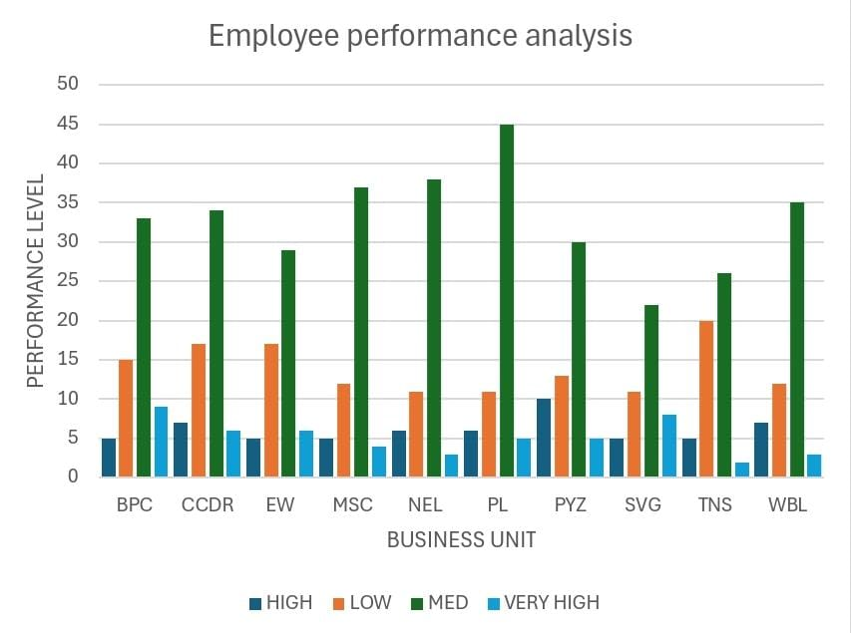
RESULTS
12

Slide 13
conclusion
The chart shows NEL and TNS with the highest number of "Very High" performers, indicating strong performance. Most business units have a balanced distribution of performance levels. PYZ and WBL show more employees in the "High" and "Medium" categories, with fewer in "Very High." EW and MSC have a noticeable presence in the "Low" category, indicating underperformance.
Recommendations for improvement:
Focus on employee training and development in EW and MSC to boost performance.
Implement mentorship or coaching programs in PYZ and WBL to elevate "High" and "Medium" performers to "Very High.“
Regular performance reviews and feedback can help maintain high standards across all units.

